Slide 1




CSE541 : Computer Vision
Mentor : Prof. Mehul Raval
Driver Drowziness Detection System
Group 4: Good Pointsss
Yesha Dhivar
Kenil Shah
Rajan Nandha
AU2040215 AU2040111
AU2040101

Slide 2
Driver fatigue is a major cause of vehicle accidents globally, hence, there is a need to detect drowsiness to save lives and property. This project aims to develop a non-intrusive drowsiness detection system that continuously captures images and measures the state of the driver's eyes.
We have developed an alert system to alert driver when he is found to be drowsy.
Introduction

Slide 3
Convolutional Neural Networks is used to develop and train the model which can successfully detect whether the driver is drowsy or not. This would help in reducing the number of accidents happening due to sleepy driver.
The objective is to develop a non-intrusive mechanism to alert the driver and prevent any accident from occuring
Problem Statement

Slide 4


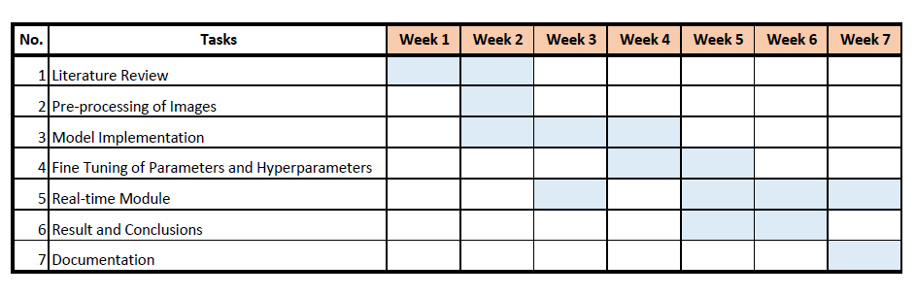


Gnatt Chart

Slide 5
Existing Body of Work
Real-time Driver Drowsiness Detection using Computer Vision
Jain, M., Bhagerathi, B., & Sowmyarani, C. N. (2021). Real-Time Driver Drowsiness Detection using Computer Vision. Blue Eyes Intelligence Engineering and Sciences Publication (BEIES).
A hybrid algorithm for facial expression recognition using Principal Component Analysis (PCA), K-Means Clustering, and Artificial Neural Networks (ANN) is proposed. It achieves an accuracy rate of 96.67% on the CK+ dataset, outperforming other existing methods.
Driver Drowsiness Detection
Navya Kiran, V. B., Raksha, R., Rahman, A., Varsha, K. N., & Dr. Nagamani, N. P. (2020). Driver Drowsiness Detection. International Journal of Engineering Research and Technology (IJERT).
A driver drowsiness detection system using OpenCV and Support Vector Machine (SVM) classifier is proposed. It achieves an accuracy rate of 95.2% in detecting drowsiness based on eye closure and head movement, providing a potential solution for preventing accidents caused by driver fatigue on the road.

Slide 6
Retrieved from: MRL Eye Dataset
Owner: Fusek, R.
Details: It contains 84898 unique images of close and open eyes.
Variation images:
Gender
With spectacles
Lighting conditions
Reflections
Images captured by:
Intel RealSense RS 300 sensor
IDS Imaging sensor
Aptina sensor.
Dataset
Dataset: http://mrl.cs.vsb.cz/eyedataset

Slide 7
APPROACH
Pre-processing of Data:
Rescaling of pixel values
Rotation
Shearing
Zooming
Horizontal and Vertical Shifting
Reduction in dimension
Tuning of Parameters and Hyperparameters:
Number of epochs
Batch size
Real-time Module:
We have developed an alert system which would observe the state of eye of the driver. Considering the parameters specified in the module, if the driver is found drowsy, an alert sound plays.
Model Architecture:
Using transfer learning, we have transferred the weights from the InceptionV3 architecture developed.

Slide 8
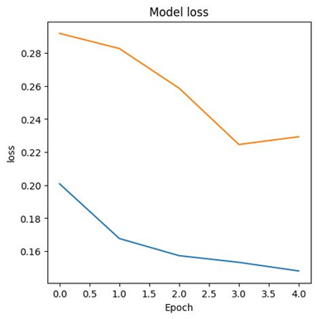
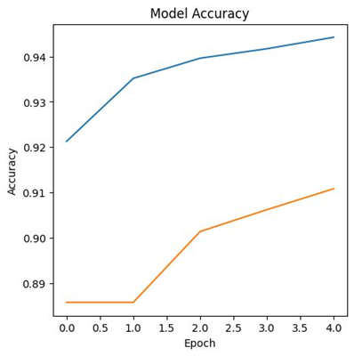
Results
Loss for Training Dataset: 12.72%
Loss for Validation Dataset: 23.57%
Accuracy for Training Dataset: 95.38%
Accuracy for Validation Dataset: 90.33%

Slide 9
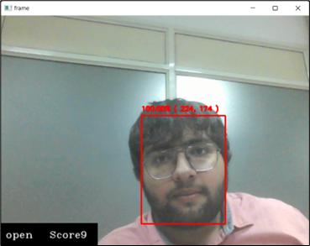
Real-time Module
The score (number of frame in which close eye is found) and state of eye is maintained at the bottom of the frame.
This values is updates every time the frame changes

Slide 10
Using transfer learning from InceptionV3, the model is developed with an accuracy of 90% and loss of 23%.
A real-time module which works as an alert system is developed to alert the drowsy driver.
Conclusion
Dataset: http://mrl.cs.vsb.cz/eyedataset

Slide 11


Distribution of Work
Rajan Nandha
AU2040101
Yesha Dhivar
AU2040215
Kenil Shah
AU2040111
Literature Review
Model Training
Fine Tuning Parameters
Real-time Module
Literature Review
Model Training
Fine Tuning Parameters
Data Exploration
Model Training
Real-time Module

Slide 12
References
[1] Fusek, R. (2018). MRL Eye Dataset. Retrieved from MRL: http://mrl.cs.vsb.cz/eyedataset
[2] Jain, M., Bhagerathi, B., & Sowmyarani, C. N. (2021). Real-Time Driver Drowsiness Detection using Computer Vision. Blue Eyes Intelligence Engineering and Sciences Publication (BEIES).
[3] Navya Kiran, V. B., Raksha, R., Rahman, A., Varsha, K. N., & Dr. Nagamani, N. P. (2020). Driver Drowsiness Detection. International Journal of Engineering Research and Technology (IJERT).

Slide 13



Thank You!

